Slide 1
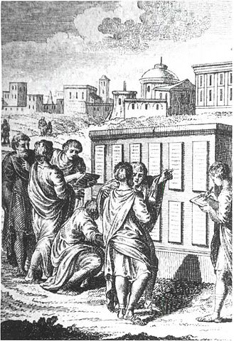
Roman Law & The Twelve Tables
DO NOW:
Read the section titled “Rome’s System of Law” on pg. 315 AND “Roman Justice” on pg. 316. Then, answer the following questions in your S.S. notebook:
Why did the plebeians demand that the laws be written down?
Rome adopted its first written code of laws in the year 451 B.C. How many years ago was that?
Once the laws had been written down, where were they posted?
True OR False: Certain ideas expressed in Roman law—like the ideas of “innocent until proven guilty” AND “the rule of law”—are used in the American legal system of today?
Notes:
They believed that patrician judges would always rule in favor of the upper classes if the laws were not written down.
2,469 years ago
They were posted in the forum (Rome’s marketplace, similar to the Greek agora) for all people to see.
TRUE

Slide 2
Ancient Roman & Modern U.S. Law
When our founding fathers were creating our United States justice system, they borrowed MANY ideas from ancient Rome, including:
innocent until proven guilty—the idea that people accused of crimes have the right to defend themselves before a judge AND that the judges MUST carefully consider all the evidence before making a decision
the rule of law—the idea that laws apply to everyone equally

